Slide 1
Iris flower Classification using Tkinter
Presented BY Dibyaranjan Das Btech(CSE) 2321322053
GUIDED BY PYTHONSOFTLLP

Slide 2
INTRODUCTION -:
This project explores the fascinating world of machine learning through the lens of the Iris flower dataset, one of the most famous datasets used for classification tasks. Our objective is to build a predictive model capable of distinguishing between the three species of Iris flowers — setosa, versicolor, and virginica — based on the physical dimensions of their petals and sepals. By applying machine learning techniques, we aim to uncover the patterns that define the uniqueness of each species.
OBJECTIVE --:
Project goal--:
Build a simple GUI-based application using Tkinter.
Perform classification of iris flowers using machine learning models
User Input the flower features via the GUI to predict the flower species.

Slide 3
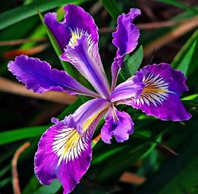
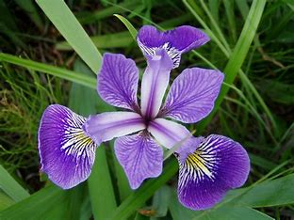
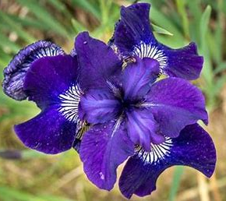
ABSTRACT
This project deals with the IRIS dataset, which includes three different iris flower species (Iris Setosa, Iris Versicolor, Iris Virginica). The dataset contains 4 physical parameters (attributes/dimensions) which can accurately predict the class of the flower. We believe that these measurements are sufficient to distinguish between the three types of Iris flowers. We'll also look at the relationship between the characteristics in each bloom and determine how important it is to represent the species. This dataset has multivariate characteristics.

Slide 4
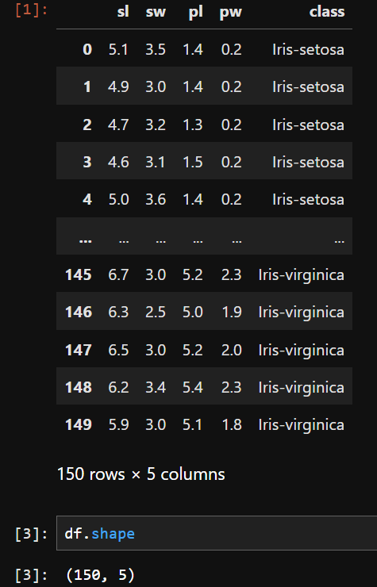
DATA DESCRIPITION
• Dataset consists of 4 features – sepal length, sepal width, petal length,petal width
• Total dataset consist of 150 datapoints .
• An early exploratory data analysis has been made on the set as shown in the picture.
•The dataset was taken from www.pythonsoft.org

Slide 5
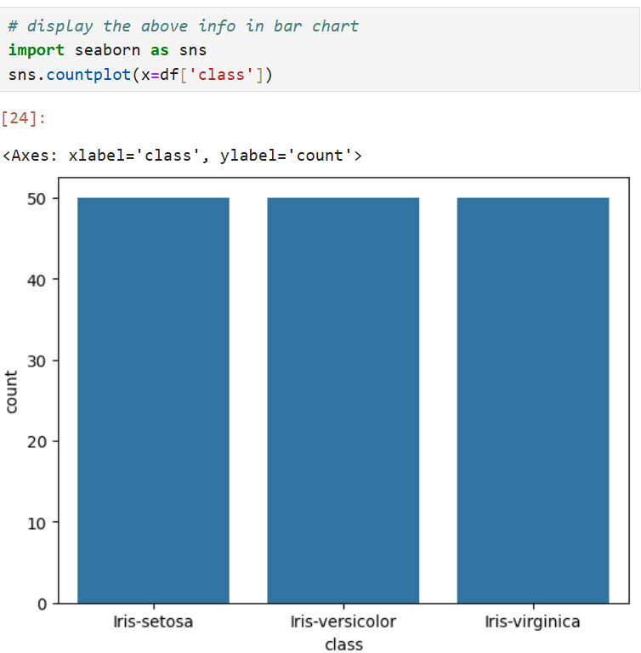
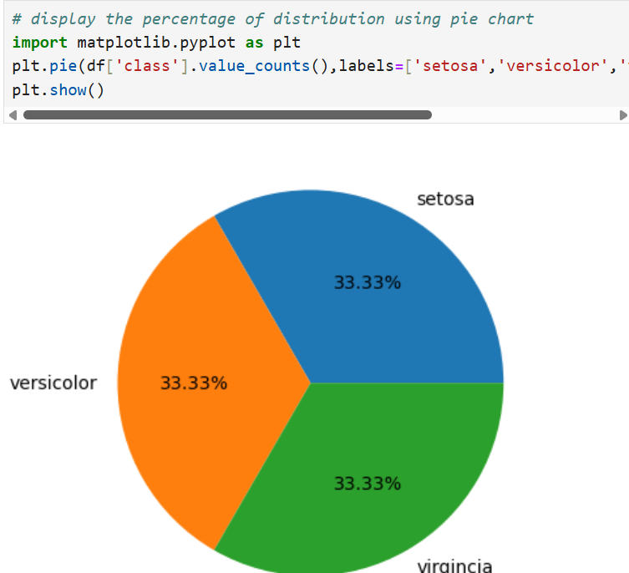
Data Visualization
Seaborn Visualization -:
* The class result diagram was created using the counterplot method on the seaborn liabrary.
Matplotlib Visualization-:
* Here are three properties of iris flower shown in matplotlib as percentage and different color,Value(),labels,atuopct Use.

Slide 6
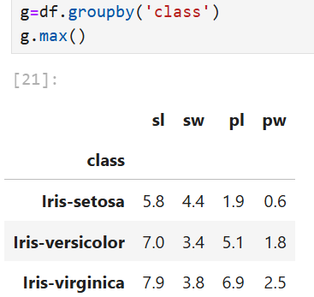
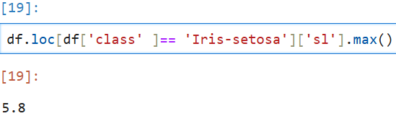
Data Preprocessing-:
___________________________________________
*Displaying the flower with highest sepal length.
*Displaying the maximun sepal length of each class by group.

Slide 7
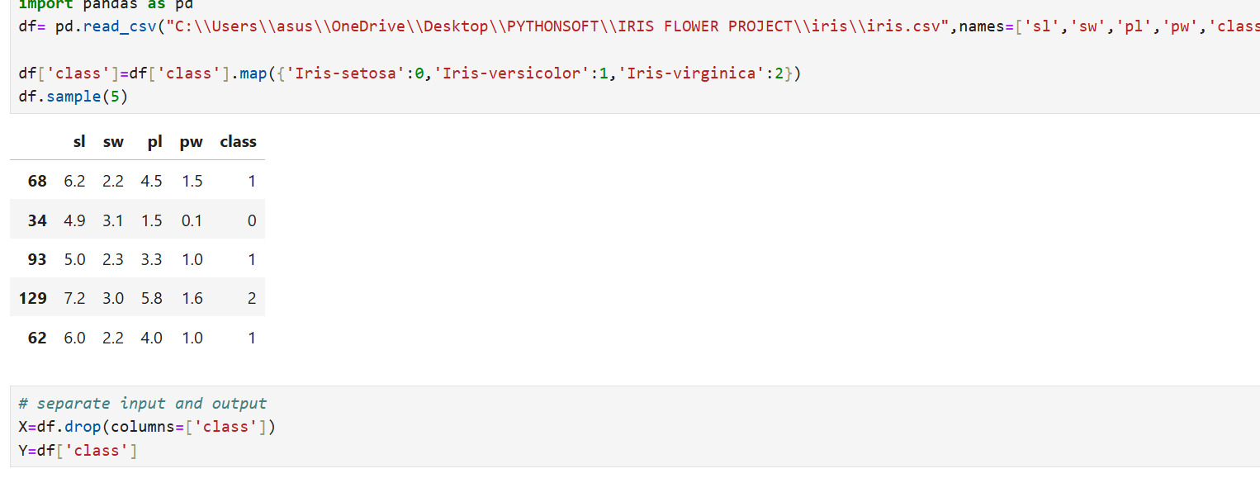
Workflow diagram-:
Here the class value has been converted to numeric using map function. And showing five sample.

Slide 8
Workflow Diagram-:
*Here spilt the data set for trainning and testing using sklearn model.
*The dataframe gets divided into X_train,X_test , y_train and y_test. X_train and y_train sets are used for training and fitting the model. The X_test and y_test sets are used for testing the model if it’s predicting the right outputs/labels.

Slide 9
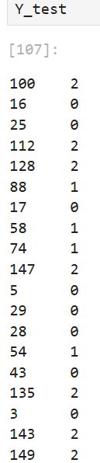
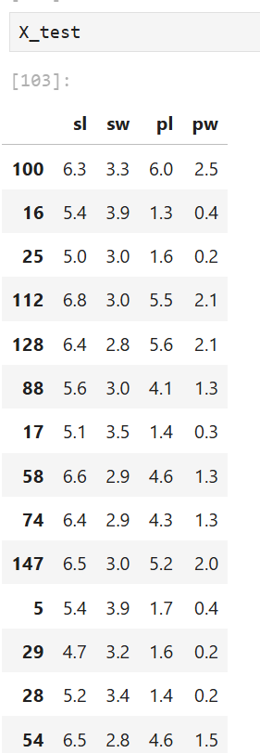
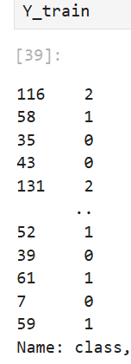
Workflow Diagram-:
You can enter a subtitle here if you need it

Slide 10
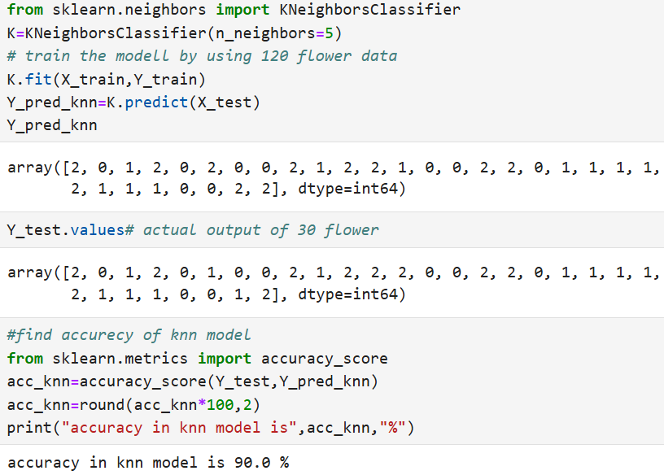
Model creation -:
*Creating knn model KNN for trainning.
-: KNN is one of the most basic yet essential classification algorithms in machine learning. It belongs to the supervised learning domain and finds intense application in pattern recognition, data mining, and intrusion detection.
-: predict the 5 neighbour data using the K neighbours algorithim and training the 120 flower data.

Slide 11
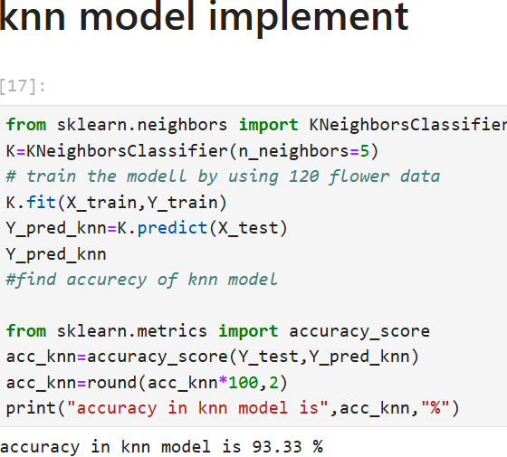
Model Creation -:
Implement the Knn Model ---:
In multilabel classification, this function computes subset accuracy: the set of labels predicted for a sample must exactly match the corresponding set of labels in y_pred_knn.
* Here showing the accuracy of Knn Model.
* Accuracy in knn model is 93.33%

Slide 12

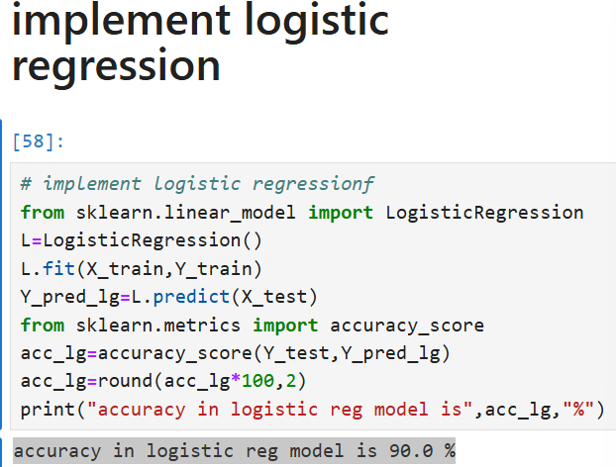
Model Creation -::
Implement the Logistic Regression Model ---:
*Logistic regression is a statistical algorithm which analyze the relationship between two data factors. The article explores the fundamentals of logistic regression, it’s types and implementations.
* Here showing the accuracy of logistic regression Model using auuracy_score method.
* Accuracy in logistic regression model is 93.33%.

Slide 13
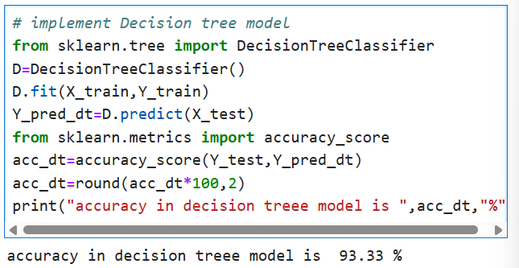
Model Creation --:
Implement the Decision tree Model ---:
*A decision tree is a flowchart-like structure used to make decisions or predictions
* Here showing the accuracy of Decision Tree Model using auuracy_score method.
* Accuracy in decision Tree model is 90.0%.

Slide 14
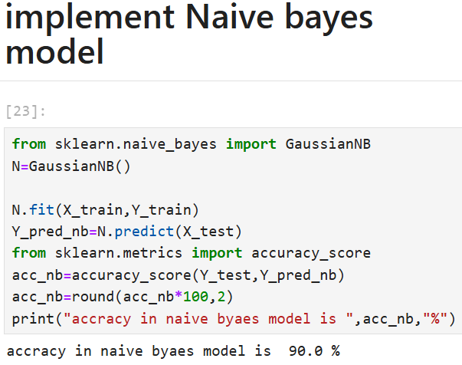
Implement Naïve bayes model --:
Implement the Naïve bayes Model ---:
*In Gaussian Naive Bayes, continuous values associated with each feature are assumed to be distributed according to a Gaussian distribution.
* Here showing the accuracy of naïve bayes model using accuracy_score method.
* Accuracy in naïve bayes model is 90.0%.

Slide 15
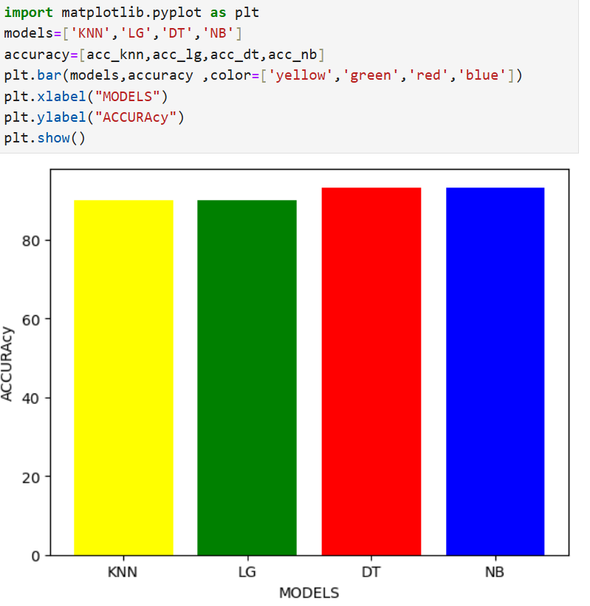
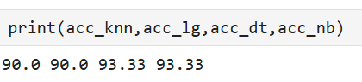
Performance Evaluation --:
* Its accuracy is shown in a bar chart comparing all model.
The acuuracy are ---:
acc_knn=90.0
acc_lg=90.0
acc_dt=93.33
acc_nb=93.33

Slide 16
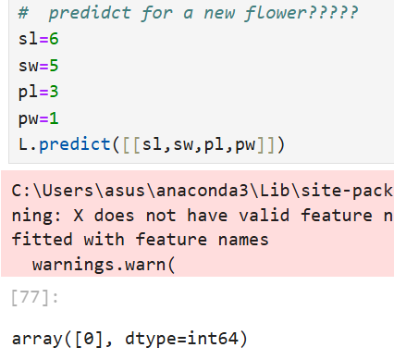
Performance Evaluation --:
A new flower is predicted using the iris specific example.
Here,
0 to 0.9=iris setosa
1 to 1.9 = iris versicolor
2 to 2.9= iris virginisa

Slide 17

Devlop the GUI using tkinter

Slide 18
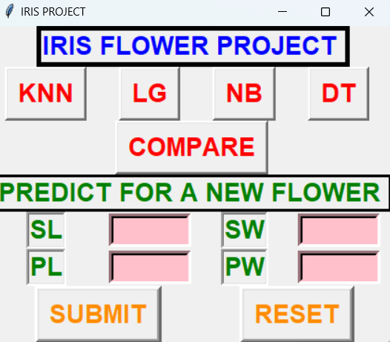
Implementation using gui---:
GUI COMPONETS --:
Labels for feature input ( Sepal Length, Sepal width, Petal Length,Petal Width).
Entry widgets for user inputs.
SUBMIT Button for prediction and Reset button for reset all data.
Label to display the prediction result.

Slide 19
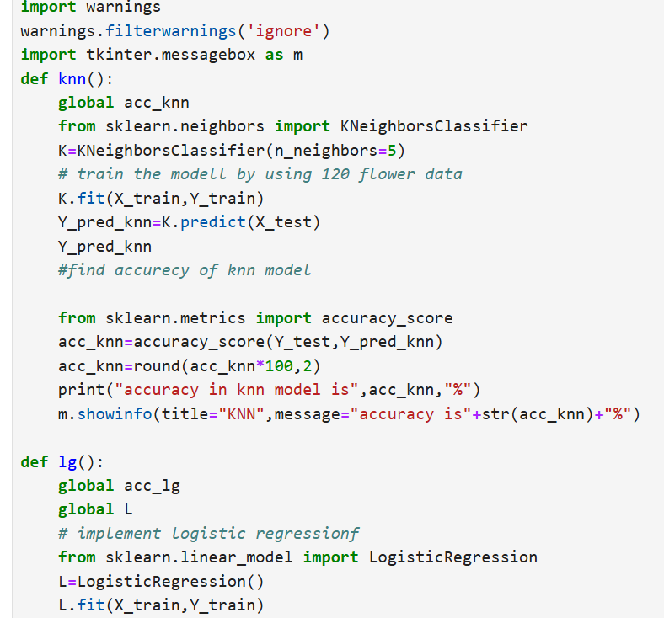
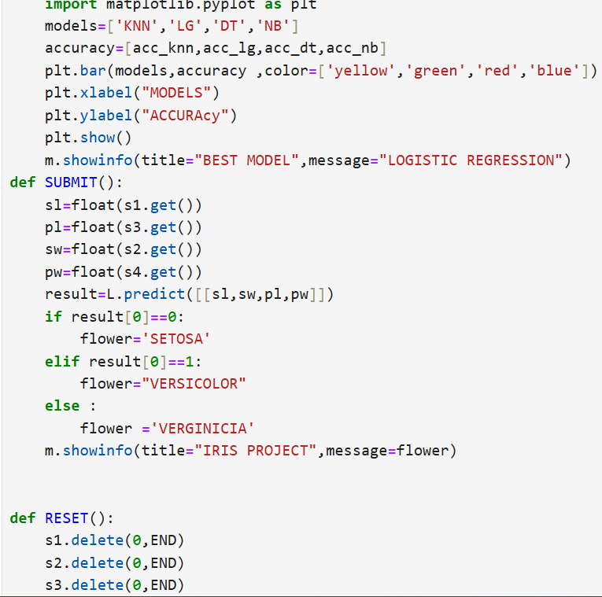
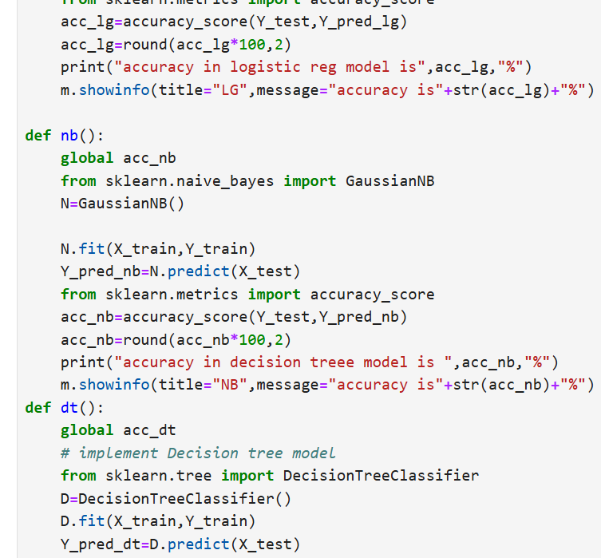
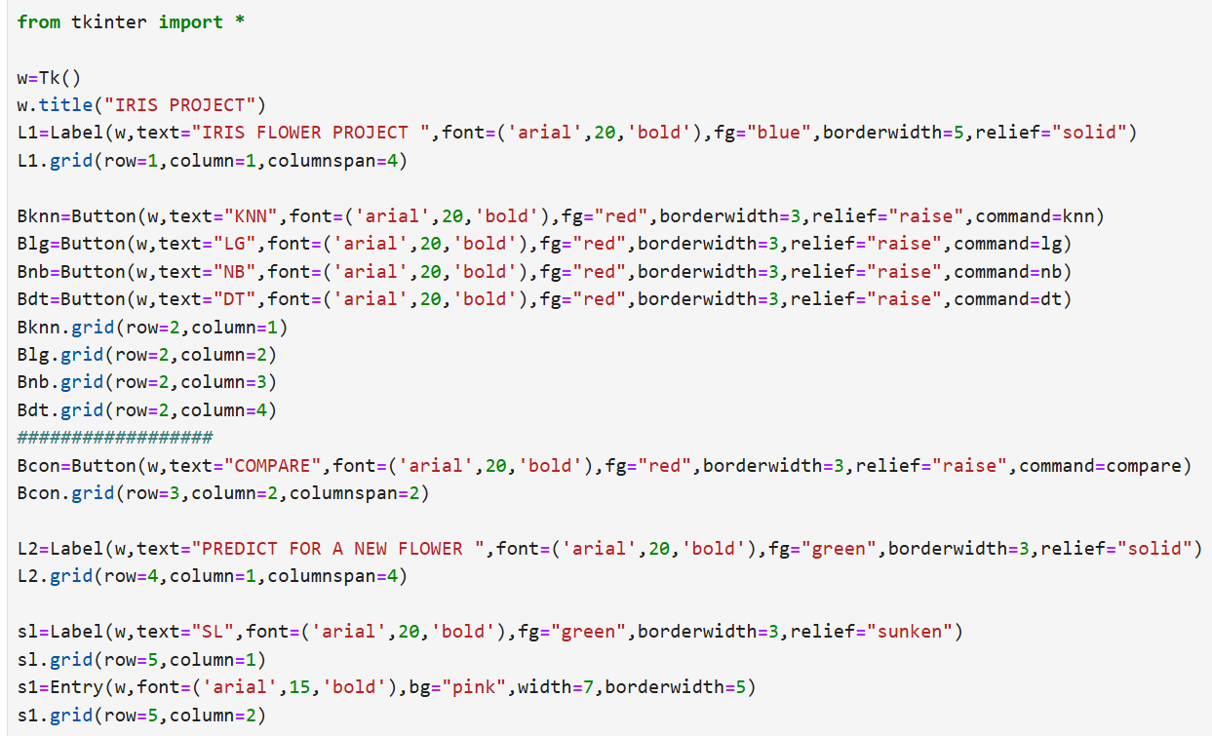
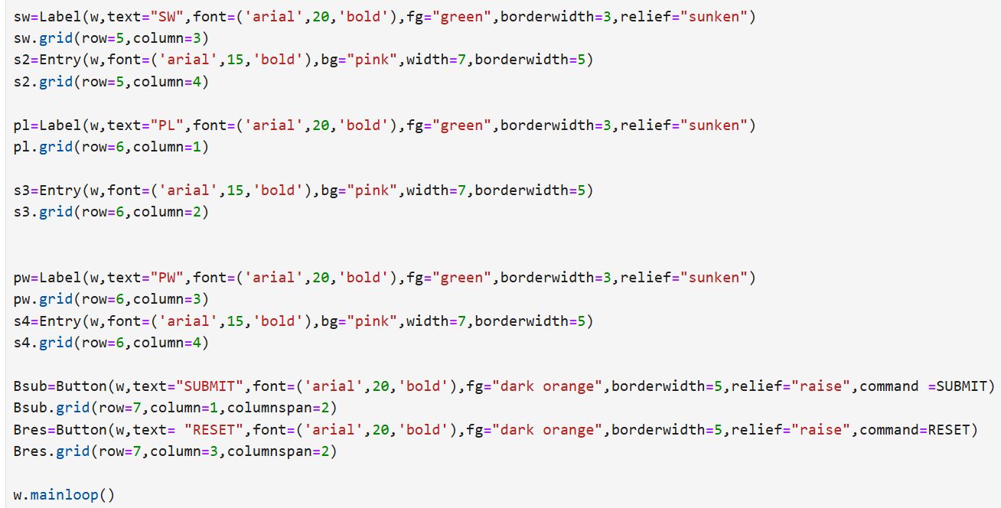
CODE WOLKTHROUGH --:

Slide 20

CONCLUSION --:
SUMMARY--:
* Built a user-friendly GUI for iris Flower classification.
* Sucessfully integrated a machine learning model.
FUTURE WORK --:
Adding more advanced models.
Incorporating data visuialization within the GUI.
Name-: Dibyaranjan Das
Reg No-: 2321322053
Branch-: CSE
Institute-:EATM(Bhubaneswar)
Special Guided by PythonsoftLLP

